Slide 1

DABIGATRAN in Daily Use: Facts & Opinions
Georges Ghanem MD, FESC, FACC
Associate Professor, Chief of Cardiology
UMC-RH/LAU-SOM
Beirut, Lebanon

Slide 2
Dabigatran is the first new oral anticoagulant to become available for clinical use in >50 years.

Slide 3
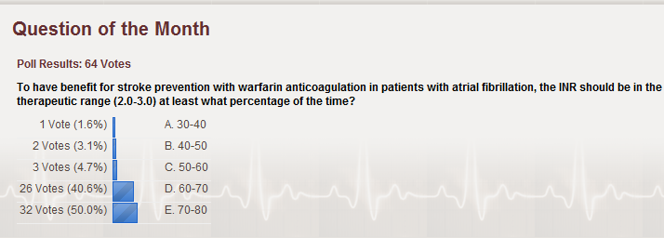
Opinions from Polls

Slide 4
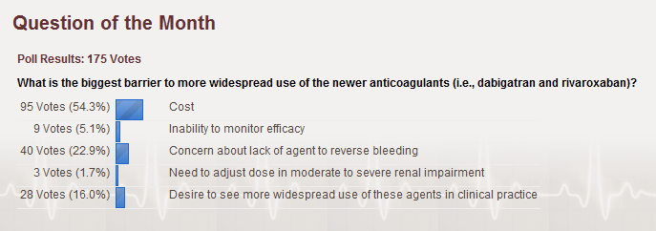
Opinions from Polls

Slide 5
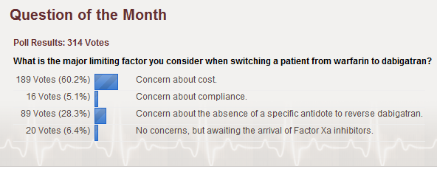
Opinions from Polls

Slide 6


THE RE-LY® STUDY:
RANDOMIZED EVALUATION OF
LONG-TERM ANTICOAGULANT THERAPY
Dabigatran compared with warfarin in 18,113 patients with atrial fibrillation at risk of stroke
Dabigatran etexilate is not approved for clinical use in stroke prevention in atrial fibrillation outside the US and Canada
Connolly SJ, et al. N Engl J Med 2009;361:1139-1151.
Notes:
6
The RE-LY® study: Randomized Evaluation of Long-term anticoagulant therapY
The final part of this presentation looks in detail at the landmark RE-LY® study¹, which compared dabigatran etexilate with warfarin for stroke prevention in patients with AF, including:
study design
patient characteristics
efficacy results
safety results.
When presenting the following slides, it should be noted that dabigatran etexilate is currently in clinical development and not licensed for clinical use in stroke prevention for patients with AF.
References
Connolly SJ, Ezekowitz MD, Yusuf S, et al. Dabigatran versus warfarin in patients with atrial fibrillation. N Engl J Med 2009;361:1139–1151.

Slide 7


RATE OF STROKE OR SSE
RR 0.65 (95% CI: 0.52–0.81)
P<0.001 (superiority)
RRR
35%
RR 0.90 (95% CI: 0.74–1.10)
P<0.001 (non-inferiority)
1.8
1.5
1.71
1.2
1.54
Rate per year (%)
0.9
1.11
0.6
0.3
0
D150 mg BID
D110 mg BID
Warfarin
Events/n:
134 / 6,076
183 / 6,015
202 / 6,022
D = dabigatran; RR = relative risk; RRR = relative risk reduction; SSE = systemic embolism.
Dabigatran etexilate is not approved for clinical use in stroke prevention in atrial fibrillation outside the US and Canada.
Connolly SJ, et al. N Engl J Med 2010;363:1875-1876.
Notes:
RE-LY® – Rate of stroke or SSE
This slide shows the absolute event rates for the primary endpoint of stroke or SSE from the three treatment arms of the RE-LY® study:¹
Dabigatran etexilate 150 mg BID = 1.11% per year
Dabigatran etexilate 110 mg BID = 1.54% per year
Warfarin = 1.71% per year.
Both doses of dabigatran etexilate were non-inferior to warfarin (P<0.001).¹
In addition, dabigatran 150 mg BID demonstrated superiority, reducing the risk of stroke or SSE by 35% compared with warfarin.¹
References
Connolly SJ, Ezekowitz MD, Yusuf S, et al. Newly identified events in the RE-LY trial. N Engl J Med 2010;363:1875–1876.

Slide 8
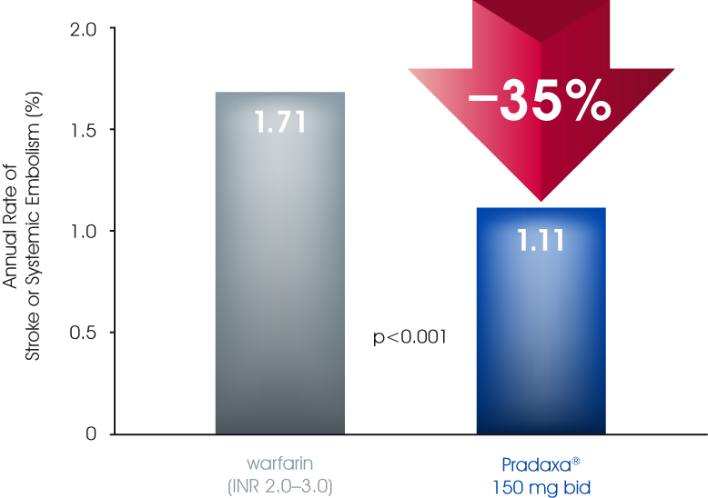
Dabigatran 150 mg bid provided superior stroke prevention vs warfarin^{1,2}
35% reduced in risk of stroke or SE vs well-controlled warfarin (INR 2.0−3.0)^{1,2} ITT data
    1. Connolly SJ et al. N Engl J Med 2009; 361:1139–1151. 2. Connolly SJ et al. N Engl J Med 2010; 363:1875–1876 (letter to editor).

Slide 9
HAEMORRHAGIC STROKE
RR 0.26 (95% CI: 0.14–0.49)
P<0.001 (superiority)
RRR
74%
RR 0.31 (95% CI: 0.17–0.56)
P<0.001 (superiority)
50
RRR
69%
40
45
0.38%
30
Number of pateitns with event
20
10
12
0.10%
14
0.12%
0
D150 mg BID
D110 mg BID
Warfarin
6,076
6,015
6,022
D = dabigatran; RR = relative risk; RRR = relative risk reduction.
Dabigatran etexilate is not approved for clinical use in stroke prevention in atrial fibrillation outside the US and Canada.
Connolly SJ, et al. N Engl J Med 2009;361:1139-1151.
Notes:
RE-LY® – Haemorrhagic stroke
Intracranial bleeding, and especially haemorrhagic stroke, is the most devastating complication of VKA therapy.¹
As this slide shows, both dosages of dabigatran etexilate dramatically reduced the risk of haemorrhagic stroke compared with warfarin:¹
Dabigatran etexilate 150 mg BID: 74% reduction (relative risk = 0.26 [95% CI: 0.14–0.49], P<0.001)
Dabigatran etexilate 110 mg BID: 69% reduction (relative risk = 0.31 [95% CI: 0.17–0.56], P<0.001).
Therefore, the superior efficacy of dabigatran etexilate 150 mg BID over warfarin for prevention of stroke and systemic embolism does not come at the cost of an increased risk of haemorrhagic stroke.¹
The combination of at least comparable efficacy in preventing strokes with a marked reduction in the risk of haemorrhagic stroke with dabigatran etexilate¹ represents an important benefit compared with warfarin, given the often severe and potentially life-threatening consequences of this complication.
Reference
Connolly SJ, Ezekowitz MD, Yusuf S, et al. Newly identified events in the RE-LY trial. N Engl J Med 2010;363:1875–1876.

Slide 10
LIFE-THREATENING BLEEDING RATES
RR 0.80 (95% CI: 0.66–0.98)
P=0.03 (superiority)
RRR
20%
RR 0.67 (95% CI: 0.54–0.82)
P<0.001 (superiority)
2.0
RRR
33%
1.5
1.85
1.49
Rate (% per year)
1.0
1.24
0.5
0
D150 mg BID
D110 mg BID
Warfarin
Events/n:
179 / 6,076
147 / 6,015
218 / 6,022
D = dabigatran; RR = relative risk; RRR = relative risk reduction.
Dabigatran etexilate is not approved for clinical use in stroke prevention in atrial fibrillation outside the US and Canada.
Connolly SJ, et al. N Engl J Med 2010;363:1875-1876.
Notes:
RE-LY® – Life-threatening bleeding rates
Rates of life-threatening bleeding in RE-LY® were:¹
dabigatran etexilate 150 mg BID = 1.49% per year
dabigatran etexilate 110 mg BID = 1.24% per year
warfarin = 1.85% per year.
Both doses of dabigatran etexilate significantly reduced the risk of life-threatening bleeding compared with warfarin:¹
dabigatran etexilate 150 mg BID = 20% reduction (relative risk = 0.80 [95% CI: 0.66–0.98], P=0.03)
dabigatran etexilate 110 mg BID = 33% reduction (relative risk = 0.67 [95% CI: 0.54–0.82], P<0.001).
Life-threatening bleeding was a subcategory of major bleeding that comprised any of:²
fatal bleeding
symptomatic intracranial bleeding
bleeding with a ≥50 g/L decrease in haemoglobin level
bleeding requiring transfusion of ≥4 units of blood or inotropic agents or necessitating surgery.
References
Connolly SJ, Ezekowitz MD, Yusuf S, et al. Newly identified events in the RE-LY trial. N Engl J Med 2010;363:1875–1876.
Connolly SJ, Ezekowitz MD, Yusuf S, et al. Dabigatran versus warfarin in patients with atrial fibrillation. N Engl J Med 2009;361:1139–1151.

Slide 11
RE-LY® IN PERSPECTIVE
Meta-analysis of
ischaemic stroke or systemic embolism
Warfarin vs. placebo
Warfarin vs. low dose warfarin
Warfarin vs. ASA
Warfarin vs. ASA + clopidogrel
Warfarin vs. ximelagatran
Warfarin vs. dabigatran 150 mg BID
0
0.3
0.6
0.9
1.2
1.5
1.8
2.1
Favours warfarin
Favours other treatment
ASA = acetylsalicylic acid.
Dabigatran etexilate is not approved for clinical use in stroke prevention in atrial fibrillation outside the US and Canada.
Camm J. Oral presentation at ESC on 30 Aug 2009 http://www.escardio.org/congresses/esc-2009/webcasts/pages/sunday.aspx
Notes:
RE-LY® in perspective
This slide presents the results of RE-LY® in the context of other trials comparing warfarin with either placebo or other antithrombotic therapies.¹
Dose-adjusted warfarin can be a highly effective treatment for stroke prevention in AF, reducing the risk of stroke by 64% in a meta-analysis of clinical trials.²
However, VKAs such as warfarin have important limitations that make their use challenging and can result patients receiving no or suboptimal protection, and so other treatments that might match the efficacy of warfarin but are easier to use in clinical practice have been sought.
Most of the alternative approaches that have been tested have failed to match the efficacy of dose-adjusted warfarin, including fixed, low-dose warfarin,³ Aspirin² and dual antiplatelet therapy with Aspirin plus clopdiogrel.⁴
The DTI ximelagatran displayed comparable efficacy to adjusted-dose warfarin,⁵ but was withdrawn from the market in 2006 due to the risk of serious liver toxicity.
In contrast to all of these earlier studies, RE-LY® demonstrated that an alternative to warfarin could be more effective for stroke prevention in AF, with dabigatran 150 mg BID reducing the risk of stroke or systemic embolism by 35% compared with warfarin (P<0.001).⁶
References
Camm J. Oral presentation at ESC on 30 Aug 2009 http://www.escardio.org/congresses/esc-2009/webcasts/pages/sunday.aspx
Hart RG, Pearce LA, Aguilar MI. Meta-analysis: antithrombotic therapy to prevent stroke in patients who have nonvalvular atrial fibrillation. Ann Intern Med 2007;146:857–867.
Gulløv AL, Koefoed BG, Petersen P, et al. Fixed minidose warfarin and Aspirin alone and in combination vs. adjusted-dose warfarin for stroke prevention in atrial fibrillation: Second Copenhagen Atrial Fibrillation, Aspirin, and Anticoagulation Study. Arch Intern Med 1998;158:1513–1521.
ACTIVE Investigators. Clopidogrel plus Aspirin versus oral anticoagulation for atrial fibrillation in the Atrial fibrillation Clopidogrel Trial with Irbesartan for prevention of Vascular Events (ACTIVE W): a randomized controlled trial. Lancet 2006;367:1903–1912.
SPORTIF Investigators. Stroke prevention in atrial fibrillation: pooled analysis of SPORTIF III and V trials. Am J Manag Care 2004; 10 suppl:S462-S469.
Connolly SJ, Ezekowitz MD, Yusuf S, et al. Newly identified events in the RE-LY trial. N Engl J Med 2010;363:1875–1876.

Slide 12

NET CLINICAL BENEFIT AND COMPONENTS
Characteristic | Dabigatran 150 mg | Dabigatran 110 mg | Warfarin | P value D150 vs. W | P value D110 vs. W
Number of patients | 6,076 | 6,015 | 6,022
Net clinical benefit | 7.11 | 7.34 | 7.91 | 0.02 | 0.09
Stroke or SSE | 1.11 | 1.54 | 1.71 | <0.001(NI) | <0.001(NI)
 |  |  |  | <0.001(sup) | 0.30(sup)
Death | 3.64 | 3.75 | 4.13 | 0.051 | 0.13
Major bleeding | 3.32 | 2.87 | 3.57 | 0.32 | 0.003
Pulmonary embolism | 0.15 | 0.12 | 0.10 | 0.30 | 0.71
Myocardial infarction | 0.81 | 0.82 | 0.64 | 0.12 | 0.09
Data represent %/year. D = dabigatran; W = warfarin.; NI = non-inferiority; Sup = superiority; SSE = systemic embolism.
Dabigatran etexilate is not approved for clinical use in stroke prevention in atrial fibrillation outside the US and Canada.
Connolly SJ, et al. N Engl J Med 2010;363:1875-1876.
Notes:
RE-LY® – Net clinical benefit and components
The primary net clinical benefit outcome was predefined as the composite of stroke or systemic embolism (SSE), death, major bleeding, pulmonary embolism and myocardial infarction.¹
Dabigatran etexilate 150 mg BID was superior to warfarin for the net clinical benefit (P=0.02) and, with regards the components:¹
significantly reduced the risk of stroke or SSE (P<0.001)
was comparable to warfarin for death (P=0.051), major bleeding (P=0.32), pulmonary embolism (P=0.30), and myocardial infarction (P=0.12).
Dabigatran etexilate 110 mg BID was comparable to warfarin for the net clinical benefit (P=0.09) and, with regards the components:¹
significantly reduced the risk of major bleeding (P=0.003)
was comparable to warfarin for stroke or systemic embolism (P=0.30), death (P=0.13), pulmonary embolism (P=0.71) and myocardial infarction (P=0.09).
Regarding the numerically higher incidence of myocardial infarction with dabigatran etexilate compared with warfarin, it should be noted that the overall incidence was relatively low compared with other outcomes and that the overall benefit of treatment was in favour of dabigatran etexilate.²
The lower rates of myocardial infarction in the warfarin arm may reflect greater potency against coronary events than other antithrombotics.
Rates of myocardial infarction were also found to be lower with warfarin in the ACTIVE W study, which compared warfarin with dual antiplatelet therapy with clopidogrel plus Aspirin for stroke prevention AF.³
References
Connolly SJ, Ezekowitz MD, Yusuf S, et al. Newly identified events in the RE-LY trial. N Engl J Med 2010;363:1875–1876.
Connolly SJ, Ezekowitz MD, Yusuf S, et al. Dabigatran versus warfarin in patients with atrial fibrillation. N Engl J Med 2009;361:1139–1151.
ACTIVE Investigators. Clopidogrel plus Aspirin versus oral anticoagulation for atrial fibrillation in the Atrial fibrillation Clopidogrel Trial with Irbesartan for prevention of Vascular Events (ACTIVE W): a randomized controlled trial. Lancet 2006;367:1903–1912.

Slide 13

Dabigatran 150 mg bid prevents 3 out of 4 AF-related strokes¹
Warfarin prevents 64% of strokes.² Dabigatran prevents an additional 35% of the remaining strokes or systemic embolisms^{3,4}
    1. Roskell NS et al. Thromb Haemost 2011; 102: Epub ahead of print. 2. Hart RG et al. Ann Intern Med 2007; 146:857–867. 3. Connolly SJ et al. N Engl J Med 2009; 361:1139–1151. 4.Connolly SJ et al. N Engl J Med 2010; 363:1875–1876 (letter to editor).

Slide 14
SAFETY ISSUES

Slide 15
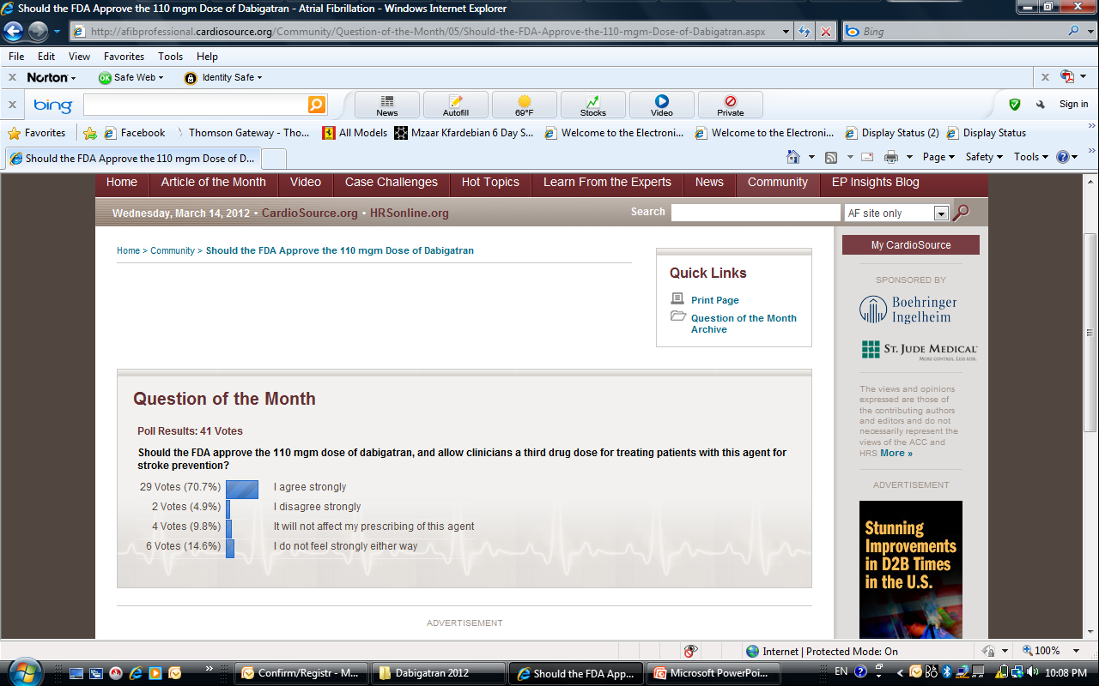
Opinions from Polls

Slide 16
Recommended dosing- Special patient populations
Patients 80 yrs or above, dosing should be reduced to 220 mg given as 110 mg BID due to the increased risk of bleeding in this population.
Patients with age between 78-80, at the discretion of the physician, when the thromboembolic risk is low and the bleeding risk is high, the lower dose 220mg can be considered.
Patients concomitantly used with verapamil, dosing should be reduced to 220 mg BID
Patients with increased bleeding risk should be monitored clinically & a dose of 220 mg, may be considered. Dose adjustment at the discretion of physician, following risk/benefit of the individual patient.

Slide 17
Special patient populations - potentially at higher risk of bleeding
Dabigatran should be used with caution in conditions with an increased risk of bleeding
Close clinical surveillance recommended throughout treatment period, especially if risk
Factors are combined.
Below summarizes factors which may increase the haemorrhagic risk.
Pharmacodynamic and kinetic factors | Age ≥75 years
Factors increasing dabigatran plasma levels | Major: Moderate renal impairment (30-50 ml/min CrCL) P-gp inhibitor co-medication Minor: Low body weight (<50 kg)
Diseases/procedures with special haemorrhagic risks | Congenital or acquired coagulation disorders Thrombocytopenia or functional platelet defects Active ulcerative GI disease Recent GI bleeding Recent biopsy or major trauma Recent ICH Brain, spinal, or ophthalmic surgery
Pharmacodynamic interactions | ASA NSAID Clopidogrel
Notes:
A coagulation test may help to identify patients with an increased bleeding risk caused by excessive dabigatran exposure.
When excessive dabigatran exposure is identified in patients at high risk of bleed, a total dose of 220 mg is recommended.
As with all anticoagulants,

Slide 18
Updated Contraindications
Severe renal impairment (CrCl < 30mL/min)
Spontaneous or pharmacological impairment of haemostasis
Active clinically significant bleeding or organic lesion at risk of bleeding
Hypersensitivity to the active substance or to any of the excipients
Concomitant treatment with:
        ketoconazole,
        cyclosporine,
        itraconazole
        tacrolimus

Slide 19
PRACTICAL ISSUES

Slide 20
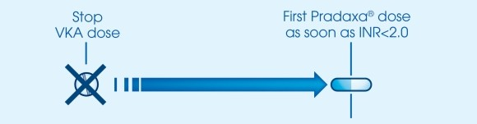
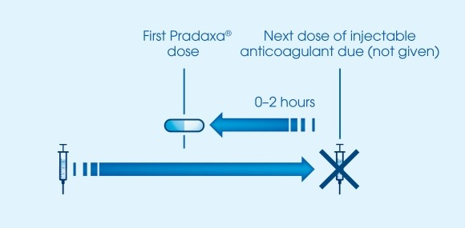
How to switch from other Anticoagulants to Dabigatran?
How to switch to Dabigatran from a vitamin K antagonist
VKA should be stopped; dabigatran should be given as soon as the patient’s INR is below 2.0
How to switch from injectable anticoagulants to Dabigatran
Dabigatran should be given 0-2 hours prior to the time that the next dose of injectable anticoagulant would be due.

Slide 21
Switching back to warfarin from Pradaxa
If you should decide to stop Pradaxa treatment and switch to warfarin/VKA therapy, renal function needs to be considered (creatinine clearance):
        For CrCl >50 mL/min, start warfarin 3 days before discontinuing Pradaxa
        For CrCl 31–50 mL/min, start warfarin 2 days before discontinuing Pradaxa
If you should decide to switch to an injectable anticoagulant should be given 12 hours after the last dose of Pradaxa

Slide 22
Missed dose
If the prescribed dose is not taken at the scheduled time, the dose should be taken as soon as possible on the same day.
A missed dose may still be taken up to 6 hours prior to the next scheduled dose. From 6 hours prior to the next scheduled dose on, the missed dose should be omitted.
Patients should not take a double dose to make up for missed individual doses.
For optimal effect and safety, it is important to take Dabigatran regularly twice a day, at approximately 12 hour intervals.

Slide 23
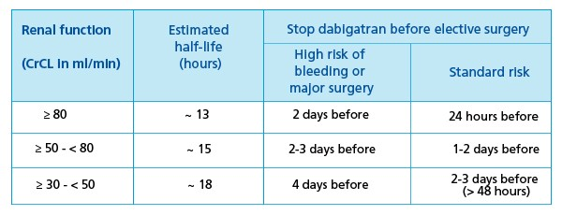
Guidance on surgery and intervention
Patients on dabigatran who undergo surgery/invasive procedures are at increased risk of bleeding. In these circumstances a temporary discontinuation of dabigatran is advisable
If emergency surgery is required, dabigatran should be temporarily discontinued.
A surgery/intervention should be delayed if possible until at least 12 hours after the last dose. If surgery cannot be delayed, the risk of bleeding may be increased.
This risk of bleeding should be weighed against the urgency of intervention.
Notes:
In patients at higher risk of bleeding, or in major surgery where complete hemostasis may be required, consider stopping Pradaxa ® 2-4 days before surgery. Clearance of dabigatran in patients with renal insufficiency may take longer. This should be considered in advance of any procedures.

Slide 24
CARDIOVERSION
In RE-LY, a total of 1,983 cardioversions were performed in 1,270 patients, with similar numbers in each treatment group (647 in the dabigatran 110mg* group, 672 in the PRADAXA 150mg group and 664 in the warfarin group).
Rates of stroke and systemic embolism within 30 days of cardioversion were low and did not differ significantly between treatment arms (0.77%, 0.3% and 0.6%, respectively; dabigatran 110mg vs. warfarin, p=0.71; PRADAXA 150mg vs. warfarin, p=0.45) though the RE-LY trial and this subgroup analysis were not powered to demonstrate statistical significance.
Similarly, major bleeding within 30 days of cardioversion was infrequent and comparable between treatment groups (1.7%, 0.6% and 0.6%, respectively).

Slide 25
Recommandations in case of bleeding / or cases of overdose
Discontinue Dabigatran
Investigate the source of bleeding
Maintain adequate diuresis before initiation of standard treatments
Surgical hemostasis
Blood volume replacement (eg, fresh whole blood or fresh frozen plasma)
Application of factor concentrates (Please note: while there is some experimental evidence to support the role of these agents, limited clinical evidence is available)
Prothrombin complex concentrates (PCC) (eg, non-activated or activated)
Recombinant activated factor VIIa (rFVlla)
Platelet concentrates may be considered when thrombocytopenia is present or long-acting antiplatelet drugs (eg, Asp or clopidogrel) have been used
Eliminate dabigatran via dialysis, constant hemoperfusion

Slide 26
Measuring Anticoagulation activity of Dabigatran
Dabigatran- No routine monitoring required
Monitoring is required for drugs with narrow therapeutic index,as warfarin, warfarin difficult to keep in range as it has variable dose response & subject to numerous interactions with drugs, diet.
Dabigatran has a predictable pharmacodynamic profile, is not affected by food, & has low potential for d–d interactions; requires no INR monitoring & no dose adjustment
NOTE: INR is very insensitive to the dabigatran treatment and cannot be recommended as a coagulation test.
Recommended tests: semi-quantitative
Activated Partial Thromboplastin Time test: An aPTT >80 seconds, or approximately 2–3-fold prolongation at trough (when the next dose is due) is associated with a higher risk of bleeding
An aPTT of approximately 1.5-fold prolongation at trough is the expected level of anticoagulation after the intake of Dabigatran 150 mg bid

Slide 27
SPECIAL OPINIONS

Slide 28
New oral anticoagulants in AF: What to do in clinical practice
Prof John Camm –March 2012
He noted that:
  the main American and European Society of Cardiology (ESC) guidelines have suggested that the new drugs are "alternatives to warfarin,"
  while new Canadian Guidelines have made the jump to the new agents being "preferred to warfarin."
  In England, NICE is encouraging of its use, stating, "Dabigatran is an important development" and "within the range considered cost-effective,"
  while the Scottish Healthcare Improvement agency says, "Warfarin remains the anticoagulant of choice, but dabigatran can be used in patients with poor INR control or those with allergies or intolerance to warfarin."

Slide 29
New oral anticoagulants in AF: What to do in clinical practice
Prof John Camm –March 2012
On which dose of dabigatran to use in which patients, Camm pointed out that the FDA chose not to approve the 110-mg dose as it couldn't find a group of patients in whom the net clinical benefit was better on 110 mg than on 150 mg.
But he noted that in Asia the 110-mg dose is standard, probably because they are smaller people and have traditionally erred toward a lower anticoagulant status.

Slide 30
2011 ACCF/AHA/HRS Focused Update on the Management of Patients With Atrial Fibrillation (Update on Dabigatran)
Dabigatran etexilate was approved by the FDA on October 19, 2010, for marketing in the United States for the prevention of stroke and systemic embolism in patients with nonvalvular AF. A dose of 150 mg twice daily was approved for patients with a creatinine clearance >30 mL/min, whereas in patients with severe renal insufficiency (creatinine clearance 15 to 30 mL/min) the approved dose is 75 mg twice daily, a dose currently marketed in the European Union but not evaluated in the RE-LY trial. There are no dosing recommendations for patients with creatinine clearance <15 mL/min or patients on dialysis.

Slide 31
Hot Topics: Why the FDA Approved Dabigatran 150 mg and Not 110 mg
Samuel Z. Goldhaber, M.D., F.A.C.C. (Disclosure)
July 22, 2011
The major problem with stroke prevention in AF is not whether dabigatran 150 mg should be used in preference to 110 mg. The key problem is that too many AF patients who should be treated with anticoagulants are treated with antiplatelet therapy or remain untreated. In an overview of studies since 2000, a median of 52% of AF patients received anticoagulants, 30% received antiplatelet therapy, and 18% were untreated.(7) Intensive educational updates, peer review, and patient advocacy will improve these metrics and should lead to a decrease in stroke incidence.

Slide 32
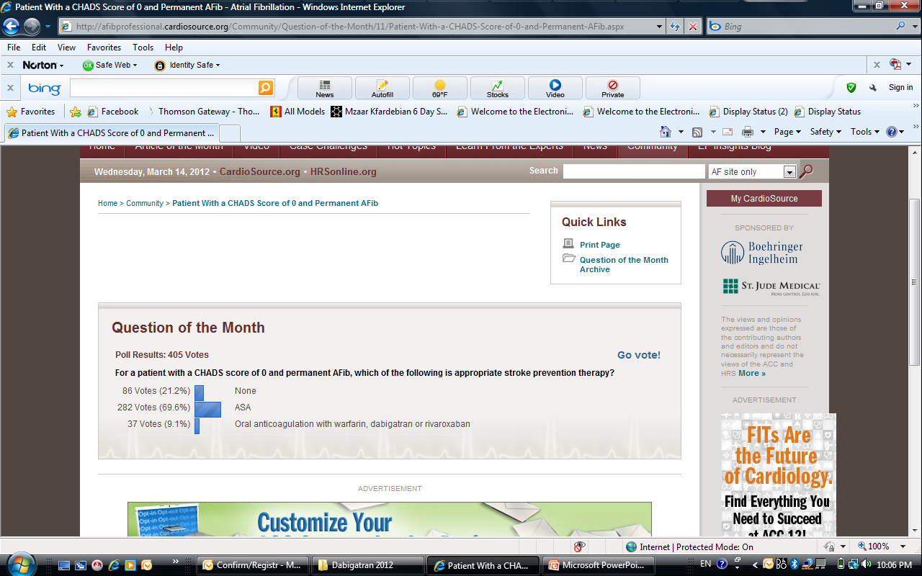
Opinions from Polls

Slide 33
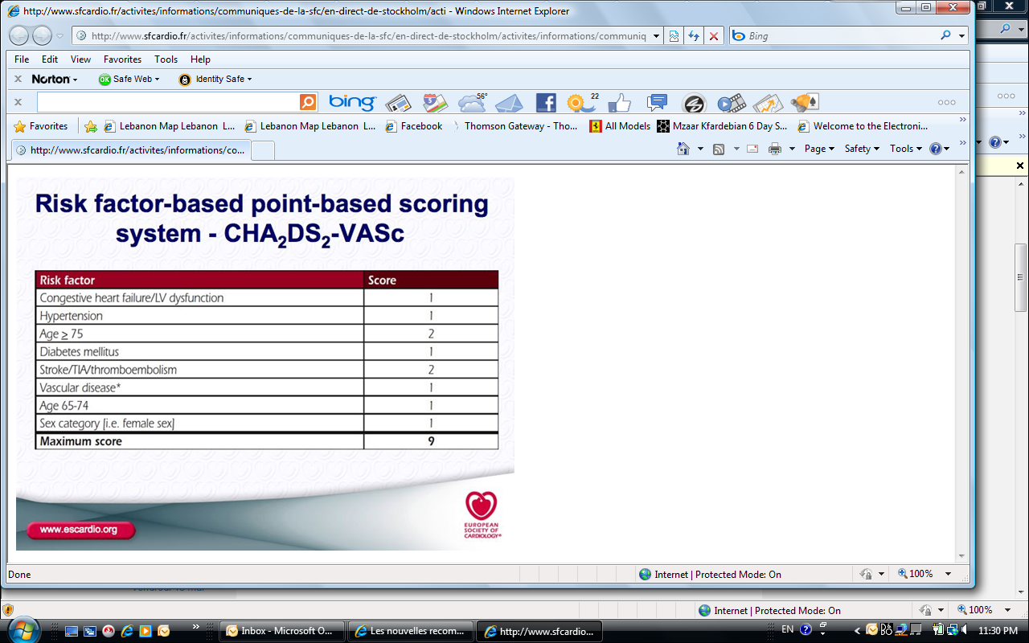

Slide 34
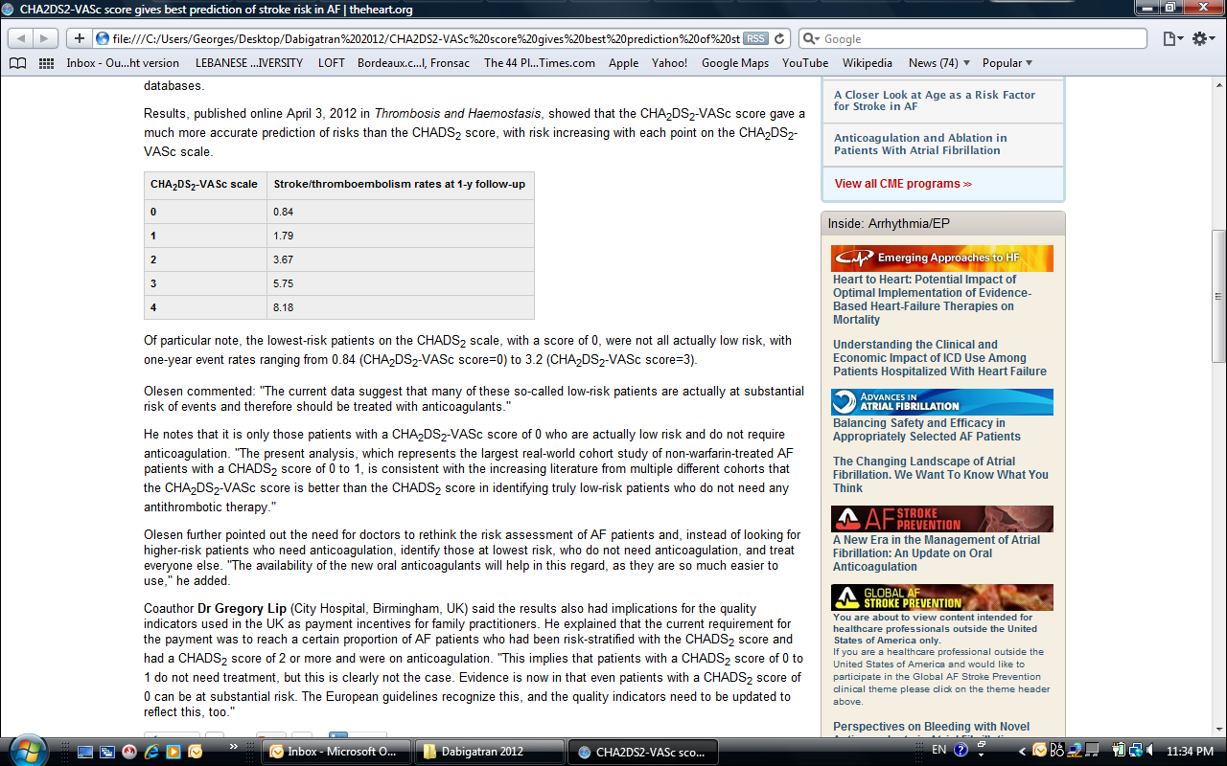

Slide 35
DABIGATRAN Myocardial Infarction Signal
Similar to what we are seeing with the high dose statin and the incidence of Diabetes…..
It is now clear that there is a small but definite signal of MI with dabigatran vs warfarin, but this is far outweighed by its benefits.
The trend is there. Let's keep an eye open and see!!!

Slide 36
CONCLUSIONS
Compared with warfarin, these new alternatives have important advantages, with their lower risk of intracranial bleeding, no clear interactions with food, fewer interactions with medications, and no need for frequent laboratory monitoring and dose adjustments.
Patients already on long-term vitamin K antagonist (VKA) treatment, with well-controlled international normalized ratio and handling VKA treatment and laboratory monitoring without problems, derive uncertain overall advantages from switching to the new oral anticoagulants, and the arguments for changing treatment in such patients appear weak.
There is also a need for more information on how to manage patients with bleeding because there are no specific antidotes for any of the new agents.
The cost of the drug at the patient level might be an obstacle to their use, although the cost-effectiveness at a societal level might be tolerable in comparison with other recently accepted novel treatments
.

Slide 37
CONCLUSIONS
Dabigatran should be avoided in severe renal failure.
Dabigatran should not be used with P-glycoprotein (Pgp) inhibitors such as verapamil, quinidine,amiodarone, or dronedarone.
There is concern over the higher dose of dabigatran in the elderly.

